Slide 1
Treasure Hunt Game
Puneeth Annam
Sai Rohith Gorla

Slide 2
Objective:
To Know the Working of Full Stack Application.
To Play a game of Treasure Hunt with 2 different colors.
When the user touches the first color, it shows the present location and to start the game.
When the user touches the second color, it shows you have reached the treasure location or not.

Slide 3
Technology Stack:
Front End : ReactJS
Backend : ExpressJS
Database : MongoDB
Platform : Web Application
IDE : VSCode
Environment : Nodejs
Deployment : Heroku

Slide 4
Published App Link :
Application was deployed on Heroku :
https://fsa-group-7.herokuapp.com/

Slide 5
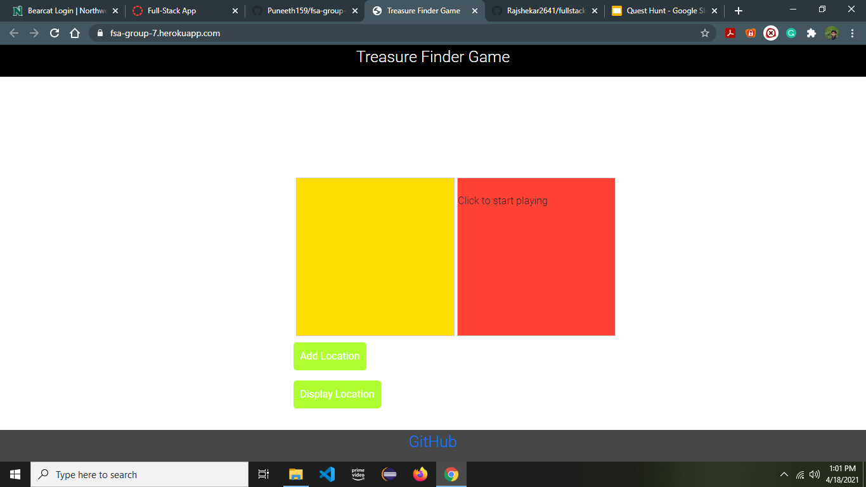
Application Screenshots :

Slide 6


Slide 7
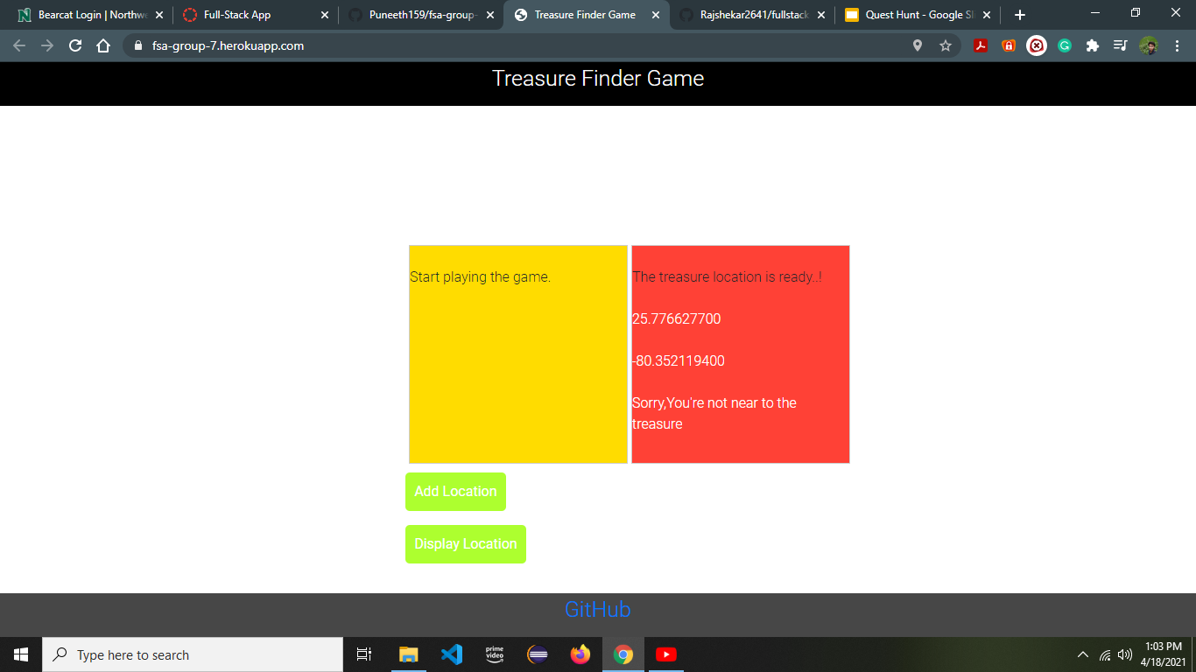

Slide 8
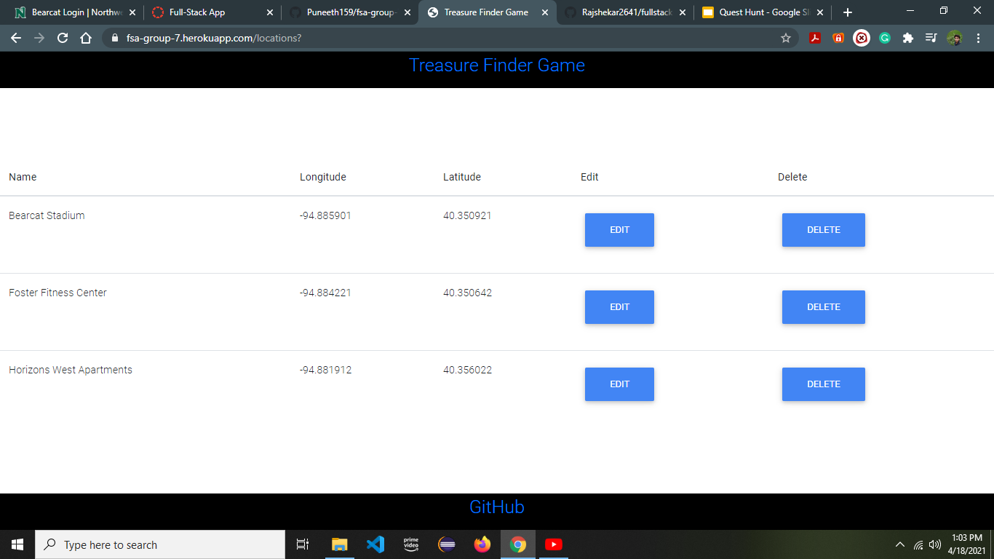

Slide 9
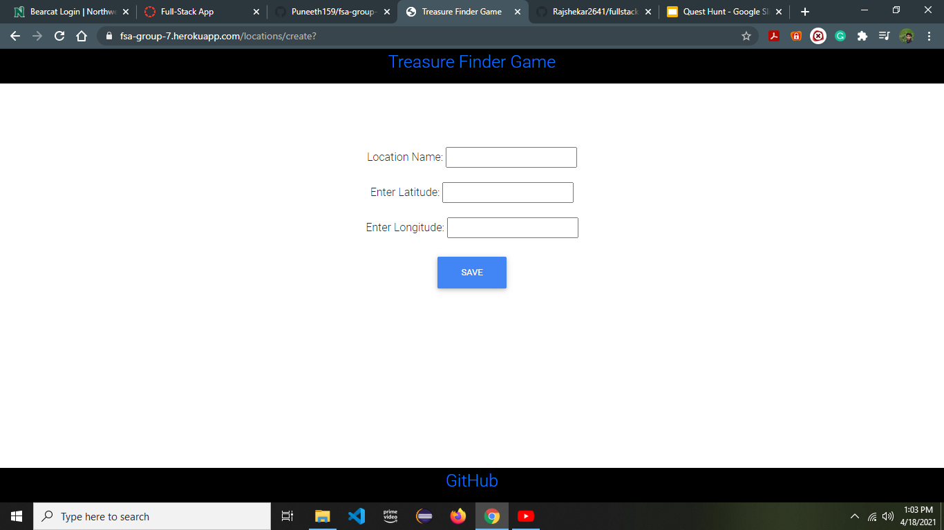

Slide 10
